Slide 1
COLOR CHANNEL FUSION NETWORK FOR LOW-LIGHT IMAGE ENHANCEMENT hannel Fusion Network Image Enhancement
Presented By:-
R E Zera Marveen Lyngkhoi (2311AI06)
Sushant Desale (2311AI09)
Submitted to:- Dr. Rajib Kumar Jha

Slide 2
Introduction:-
Due to the low-light conditions, the captured image quality is seriously degraded. It badly affects the visual effect of human eyes and limits the accuracy of further tasks such as object detection, image classification and video surveillance.
Based on past research low light image enhancement approaches was classified into four categories:
Histogram based
Fusion based
Retinex based
Data driven based

Slide 3
Color Channel Fusion Network (CCFN):-
A novel deep learning network for enhancing low-light images which consists of three parts:-
Channel Correlation Network (CCN) :- CCN improves the overall brightness of the low-light images while maintaining the relevance of RGB channels.
Multi-Scale Fusion Network (MFN) :- MFN learns the weight matrices automatically to synthesize the enhanced images and adjusts the contrast to obtain a more natural appearance.
Detail Enhancement Network (DEN) :- DEN is designed for abundant structure information.

Slide 4
Proposed Method:-
Steps:-
The RG, RB and GB channels are extracted from the original RGB images I(org).
Input to the CCN to get the preliminary enhanced RG, RB and GB channel images.
Through the reasonable allocation of fusion weights by MFN, CCN outputs are fused to obtain I(fus).
After that mean filter is used to get initial details I(det) of I(fus) and more abundant detail images I(det) are acquired by automatic learning.
Target images I(enh) are generated by adding the detail boosting images I(det) with the fusion outputs I(fus).

Slide 5
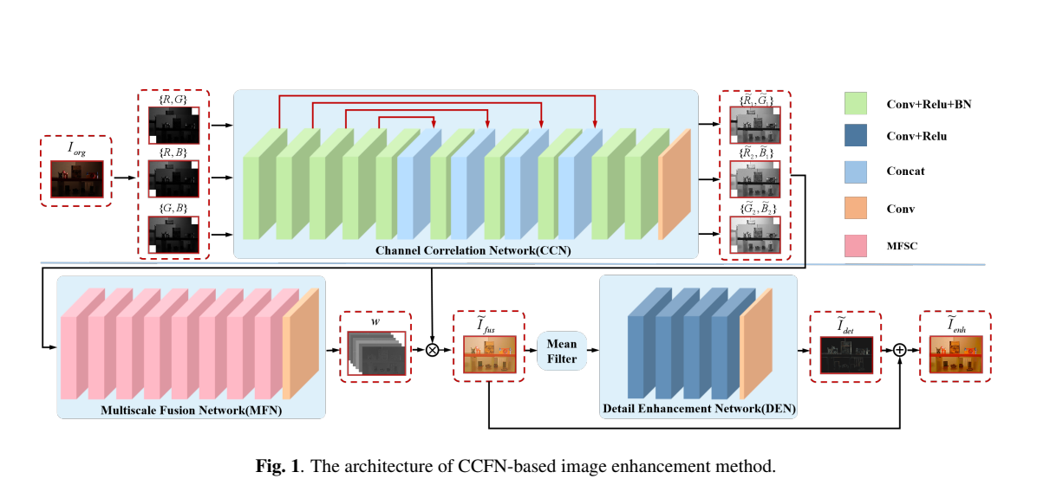

Slide 6
Channel Correlation Network (CCN):-
Enhancement based on the RGB color space always enhances these three components separately, which ignores the correlation among the components and leads to the color deviation in the enhanced images.
To overcome this color deviation CCN adopts RGB partial channel combination as RG, RB and GB channels for the whole image enhancement.
It consists of plain convolutional neural network (CNN) of eight convolutional layers with symmetrical concatenation followed by two convolutional layers. Each layer consists of 64 convolutional kernels of size 3 × 3 and stride 1 followed by batch normalization and ReLU activation function.

Slide 7

The last layer uses convolution to get the outputs I(i) pre(i = 1, 2, 3), where I(1) pre = {R˜1, G˜1}, I(2) pre = {R˜2, B˜1} and I(3) pre = {G˜2, B˜2}.
To enable the training procedure, We use loss function LCCN that is composed of reconstruction loss, color loss and channel relevance loss to let us evaluate the quality of enhanced images.
where λr, λc and λcr are weighting hyper-parameters.

Slide 8

Reconstruction Loss:-
Reconstruction Loss Minimizing the sum of absolute value of gray difference between the enhanced images I(i) pre and corresponding normal images I(nor).
Reconstruction loss LrCCN is introduced to constrain the consistency of I(i) pre and I(nor).
where I(inor)(i = 1, 2, 3) are RG, RB and GB channels extracted from I(nor) respectively. || · ||1 means l1 norm.

Slide 9

Color Loss:-
In RGB color space, the Euclidean Distance between two color points does not represent the true visual differences. Only using reconstruction loss to measure the numerical differences still leads to significant color differences.
Therefore, angle difference is considered to improve the results of RGB color differences. Color loss L CCN c sums the angle difference of the corresponding color vectors in I(i) pre and I(inor):
where ()n denotes a pixel, ∠(,) is an operation for calculating the angle between color vectors.

Slide 10
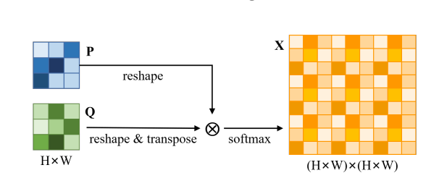
Channel Relevance Loss:-
As illustrated in above figure, given two image channels P and Q. We firstly reshape {P, Q} ∈ R(H×W×1) to R(N×1), where N = H × W is the number of pixels.

Slide 11

Then we apply a matrix multiplication between P and the transpose of Q, and perform a softmax operation to calculate the channel relevance map X ∈ R(N×N).
Channel relevance loss LcrCCN maintains the correlation between channels while the images are enhanced:
where X measures the impact of the k th position of P channel on the
jth position of Q channel in normal/enhanced images.

Slide 12
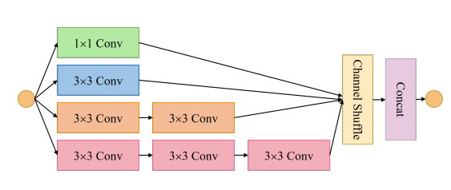
Multi-Scale Fusion Network (MFN):-
In order to make full use of the advantage of the outputs produced by CCN, MFN is trained to automatically combine them instead of simply averaging.
So we use a multi-scale feature channel shuffle module (MFCS) in the fusion stage.

Slide 13
As shown in above figure, MFCS uses different convolution kernels to simulate the Gaussian surrounding function of MSR and adaptively detects image features of different scales.
Instead of directly using 5 × 5 or 7 × 7 convolution kernels with more parameters, a different number of 3 × 3 convolution layers are used to extract context information.
As the information contained in same scales may be the same, directly combination feature maps hinders the flow of multiscale information in different characteristic channels
Channel shuffling strategy is applied after the multi-scale feature extraction, which can improve the learning ability without other parameters.
MFCS is stacked repeatedly to build MFN. A convolution layer is used to generate fusion weight maps at last.

Slide 14



The fused images with excellent visual effect are obtained by MFN: I(fus) = [w1iR˜i, w2iG˜i, w3iB˜i], (i = 1, 2) w1i,w2i and w3i are the fusion weights of CCN outputs
MFN loss function L MFN can be described as:
which including reconstruction loss, color loss, spatial consistency loss and smoothness loss. µr, µc, µp and µs are weighting hyper-parameters.
Where,

Slide 15

Spatial Consistency Loss:-
The spatial coherence is maintained by preserving the differences among adjacent regions between the enhanced images and the corresponding normal images. Spatial consistency loss LpMFN can be expressed as:
where K is the number of local regions, and Ω(i) is the 4-connected areas (top, down, left, right) of 4×4 region i. Y˜fus and Enor are denoted as the average intensity value of the fusion outputs and normal images, respectively.

Slide 16

Smoothness Loss:-
An image can be regarded as a two-dimensional discrete function, and the image gradient is the derivative of the discrete function. It helps to avoid the fuzzy boundaries and increase the hierarchy sense of images. The smoothness loss L MFN s is defined as:
where ∇ represents gradient operations including ∇x (horizontal) and ∇y (vertical).

Slide 17
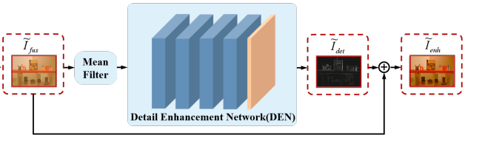
Detail Enhancement Network (DEN):-
DEN is designed to solve the problem of unclear details of the images collected under insufficient illumination.
It has 5 layers which is shown in above figure with two different types of layer: Conv+Relu and Conv

Slide 18

As for Conv+Relu, the 64 filters of size 3 × 3 with stride 1 are used to generate 64 feature maps. After Relu layer sparseness, the model can better mine the relevant features and fit the training data.
The outputs of convolution operation are RGB channel detail enhancement results.
High-frequency information forms the edges and details of the images, which can further strengthen the image contents.
As per following given equation, arithmetic mean filter (fm) of size 3 × 3 is used to get the base layers and original images I(fus) are subtracted to get the initial detail images I(det).

Slide 19
More abundant detail information images I(det) are obtained by automatic learning.
Above equation is used to guide the training process.
Final enhancement outputs I(enh) are obtained by adding up I(fus) and I(det).

Slide 20


